Slide 1
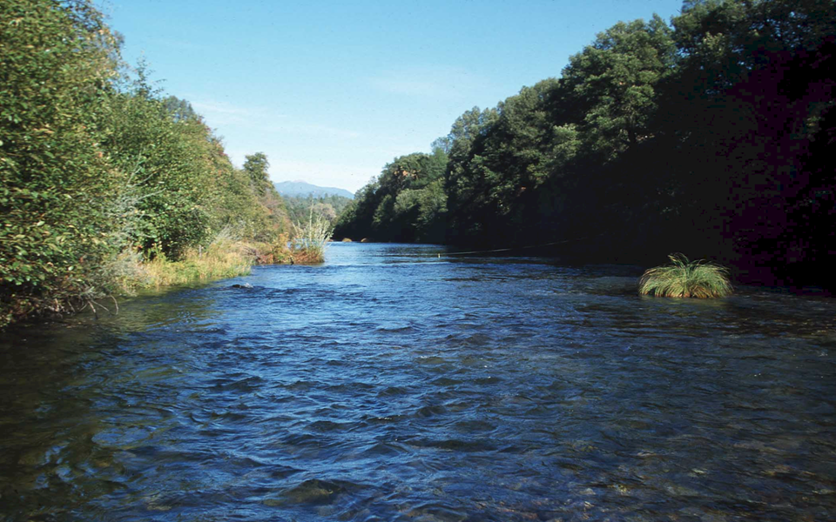
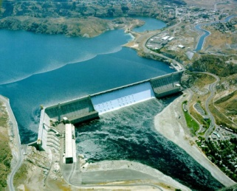
Open Channel Flow
December 18, 2012

Slide 2
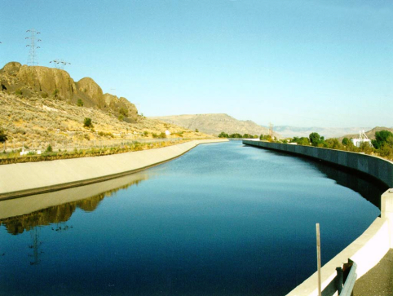
Steady-Uniform Flow: Force Balance
τ_{o}P Δx
Shear force =________
Energy grade line
P
Hydraulic grade line
Wetted perimeter = __
b
γΑΔx sinθ
c
Gravitational force = ________
Δx
a
d
W cos θ
θ
θ
Shear force
W
Hydraulic radius
W sin θ
Dimensional analysis
Relationship between shear and velocity? ___________________

Slide 3
Open Conduits: Dimensional Analysis
Geometric parameters
___________________
___________________
___________________
Write the functional relationship
Hydraulic radius (R_{h})
Channel length (l)
Roughness (ε)
Kinetic Energy
Uniform flow
Potential Energy

Slide 4
Pressure Coefficient for Open Channel Flow?
Pressure Coefficient
Mechanical Energy Loss
Kinetic Energy
Friction slope
Friction slope coefficient
The friction slope is the slope of the EGL. The friction slope is the same as the bottom slope (S_{o}) for steady, uniform flow.

Slide 5
Dimensional Analysis
Head loss ∝ length of channel
High Re for almost all open channel flows
(like f in Darcy-Weisbach)

Slide 6
Open Channel Flow Formulas
Chezy formula
Manning formula (MKS units!)
Dimensions of n?
T /L^{1/3}
Is n only a function of roughness?
NO!

Slide 7
Manning Formula
The Manning n is a function of the boundary roughness as well as other geometric parameters in some unknown way...
_______________________________
_______________________________
Hydraulic radius for wide channels
1
2
Channel curvature (bends) – K?
Cross section geometry
P₁ < P₂
R_{h1} > R_{h2}
h
b

Slide 8
Why Use the Manning Formula?
Tradition
Natural channels are geometrically complex and the errors associated with using an equation that isn’t dimensionally correct are small compared with our inability to characterize stream geometry
Measurement errors for Q and h are large
We only ever deal with water in channels, so we don’t need to know how other fluids would respond

Slide 9
Values of Manning n
The worst channel has…
Roughness at many scales!

Slide 10
Example: Manning Formula
What is the flow capacity of a finished concrete channel that drops 1.2 m in 3 km?
1
1.5 m
2
3 m
solution

Slide 11
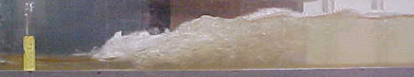
Depth as f(Q)
Find the depth in the channel when the flow is 5 m³/s
Hydraulic radius is function of depth
Area is a function of depth
Can’t solve explicitly
Use trial and error or solver

Slide 12
Open Channel Energy Relationships
Pipe flow
z - measured from horizontal datum
From diagram
Turbulent flow (α ≅ 1)
depth of flow
y - _____________
Energy Equation for Open Channel Flow

Slide 13
Specific Energy
The sum of the depth of flow and the velocity head is the specific energy:
y - _______ energy
potential
- _______ energy
kinetic
EGL
If channel bottom is horizontal and no head loss
HGL
For a change in bottom elevation

Slide 14
Specific Energy
In a channel with uniform discharge, Q
where A=f(y)
Consider rectangular channel (A = By) and Q = qB
q is the discharge per unit width of channel
y
A
3 roots (one is negative)
B
2
How many possible depths given a specific energy? _____

Slide 15
Specific Energy: Sluice Gate
sluice gate
q = 5.5 m²/s
y₂ = 0.45 m
V₂ = 12.2 m/s
EGL
1
E₂ = 8 m
vena contracta
2
Given downstream depth and discharge, find upstream depth.
alternate
y₁ and y₂ are ___________ depths (same specific energy)
Why not use momentum conservation to find y₁?

Slide 16
Specific Energy: Raise the Sluice Gate
sluice gate
EGL
1
2
as sluice gate is raised y₁ approaches y₂ and E is minimized: Maximum discharge for given energy.

Slide 17
Step Up with Subcritical Flow
Short, smooth step with rise h in channel
Given upstream depth and discharge find y₂
Energy conserved
h
Is alternate depth possible? __________________________
NO! Calculate depth along step.

Slide 18
Max Step Up
Short, smooth step with maximum rise h in channel
What happens if the step is increased further?___________
Choked flow
h

Slide 19
Step Up with Supercritical flow
Short, smooth step with rise h in channel
Given upstream depth and discharge find y₂
h
What happened to the water depth?______________________________
Increased! Expansion! Energy Loss

Slide 20
Hydraulic Jump: Dimensional Analysis
y₂
y₁
To what depth will the water rise (y₂) given y₁?
Inertia, gravity, viscous
What forces are important? ________________________
What is happening in a jump and what is it like in pipe flow?

Slide 21
Hydraulic Jump
cs₂
cs₁
y₂
y₁
Mass
Per unit width
Energy
Unknown losses

Slide 22
Hydraulic Jump
x
y₂
y₁
Momentum_{x}
or

Slide 23
Summary
Open channel flow equations can be obtained in a similar fashion to the Darcy-Weisbach equation (based on dimensional analysis)
The dimensionally incorrect Manning equation is the standard in English speaking countries
The free surface (an additional unknown) makes the physics more interesting!

Slide 24

Turbulent Flow Losses in Open Conduits
No shear stress
Maximum shear stress

Slide 25
Example

Slide 26

Grand Coulee Dam
http://users.owt.com/chubbard/gcdam/html/gallery.html

Slide 27
Columbia Basin Project
The Columbia Basin Project is a major water resource development in central Washington State with Grand Coulee Dam as the project's primary feature. Water stored behind Grand Coulee Dam is lifted by giant pumps into the Banks Lake Feeder Canal and then into Banks Lake. The water stored in Banks Lake is used to irrigate 0.5 million acres of land stretching 125 miles from Grand Coulee Dam.

Slide 28
Pumps
At the time of original construction the pumping plant contained six 65,000 horsepower pumps. Beginning in 1973 the pump bay was doubled in length to the south and six 67,500 horsepower pump/generators were added.
Each pump lifts water from Lake Roosevelt up through a 12 foot diameter discharge pipe to the feeder canal above.
The original pumps can supply water to the feeder canal at a rate of 1,600 cubic feet of water a second while the newer units can supply 2,000 cubic feet of water a second.
The new pumps are reversible and each pump can produce 50 megawatts of electrical power.
Why reversible?
Total flow=21000 ft³/s

Slide 29
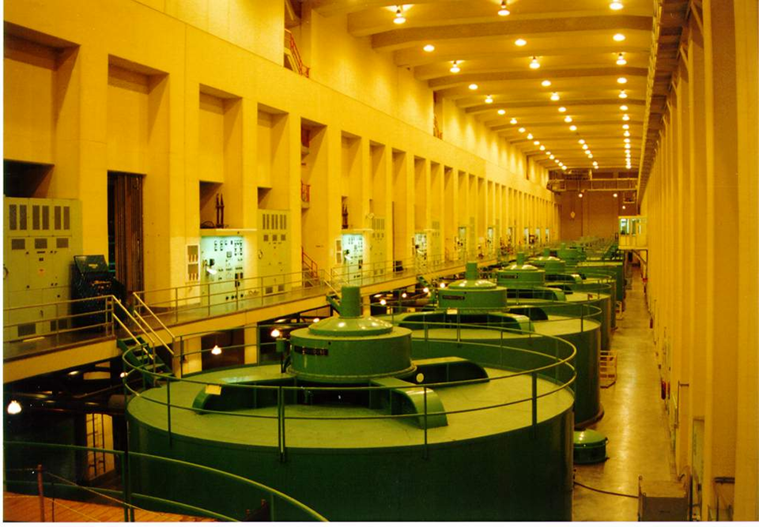

Slide 30
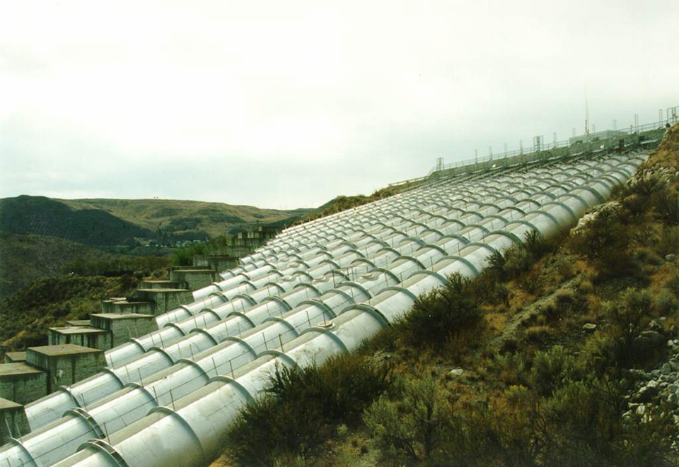

Slide 31
Grand Coulee Feeder Canal
The Grand Coulee Feeder Canal is a concrete lined canal which runs from the outlet of the pumping plant discharge tubes to the north end of Banks Lake.
The original canal was completed in 1951 but has since been widened to accommodate the extra water available from the six new pump/generators added to the pumping plant.
The canal is 1.8 miles in length, 25 feet deep and 80 feet wide at the base. It has the capacity to carry 16,000 cubic feet of water per second.

Slide 32
Columbia Basin Irrigation Project

Slide 33
Unsteady Hydraulics!
The base width of the feeder canal was increased from 50 to 80 feet; however, the operating capacity remained at 16,000 cubic feet per second.
Water depth was reduced from 25 to about 20 feet to safely accommodate wave action when the water flow is reversed as the pump-generators are changed from pumping to generating and vice-versa.
How can water from in either direction in the same canal?

Slide 34
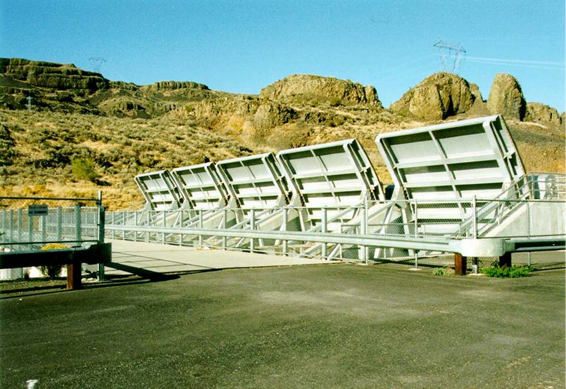
Gates

Slide 35
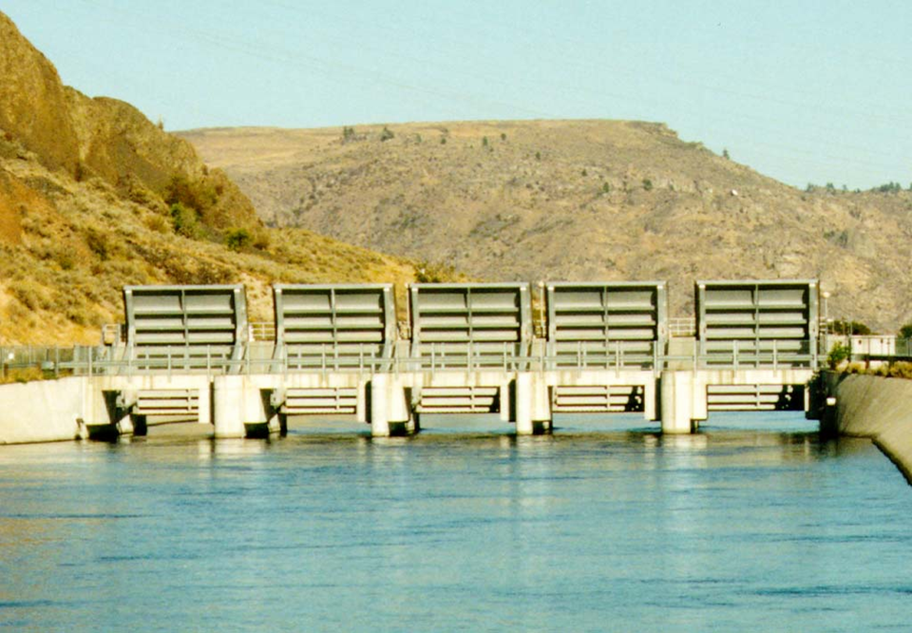
Gates

Slide 36
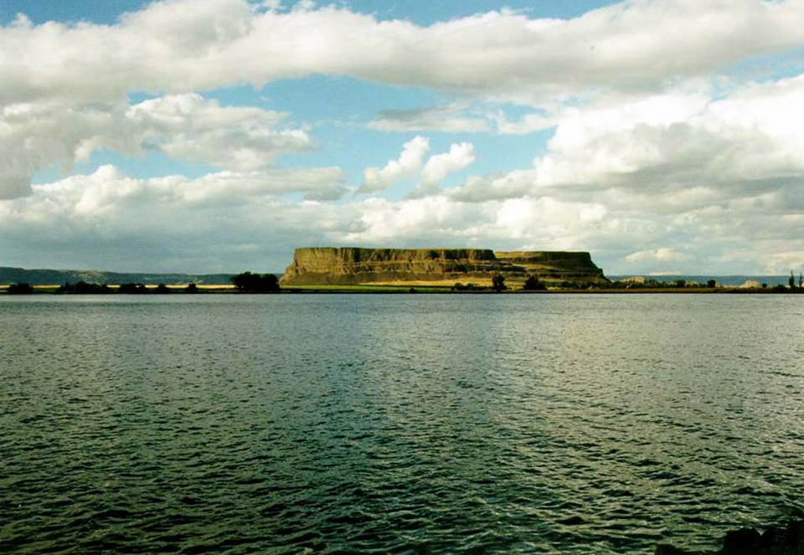
Banks Lake

